Slide 1

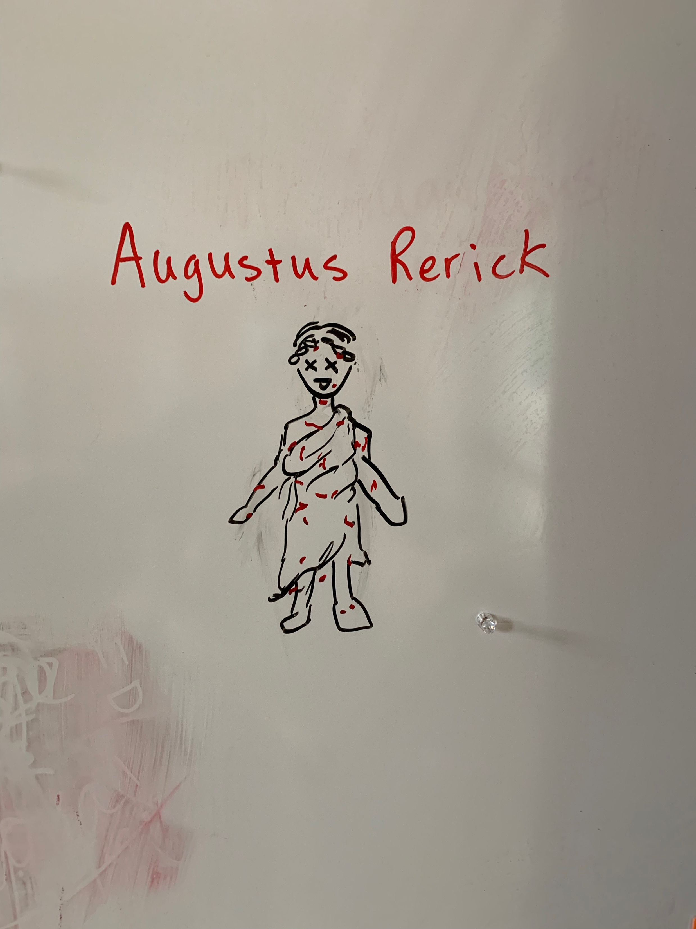

WARNING! Contract Discussion
Your HOS grade will look like Julius Caesar if you take out your cellphone.
Every time you take out your cell phone in class, Mr. Rerick rethinks his career choice and feels more inclined to give you an in class essay the next day.
Mr. Rerick’s face when he sees you with your cellphone.

Slide 2
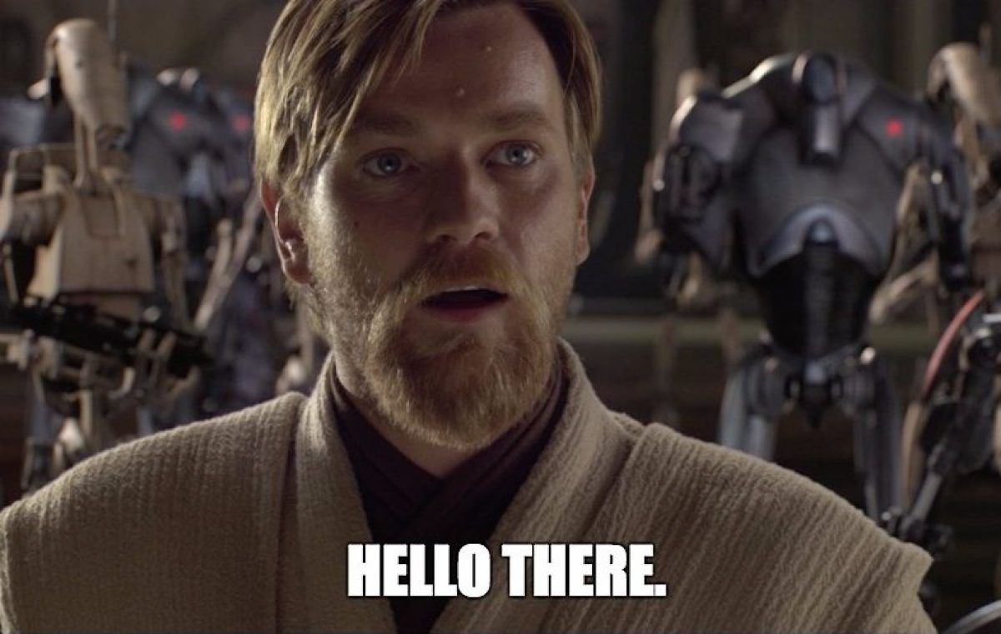
I’ll Go First…
Emmett

Slide 3

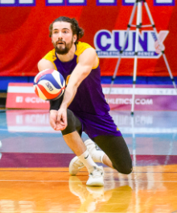
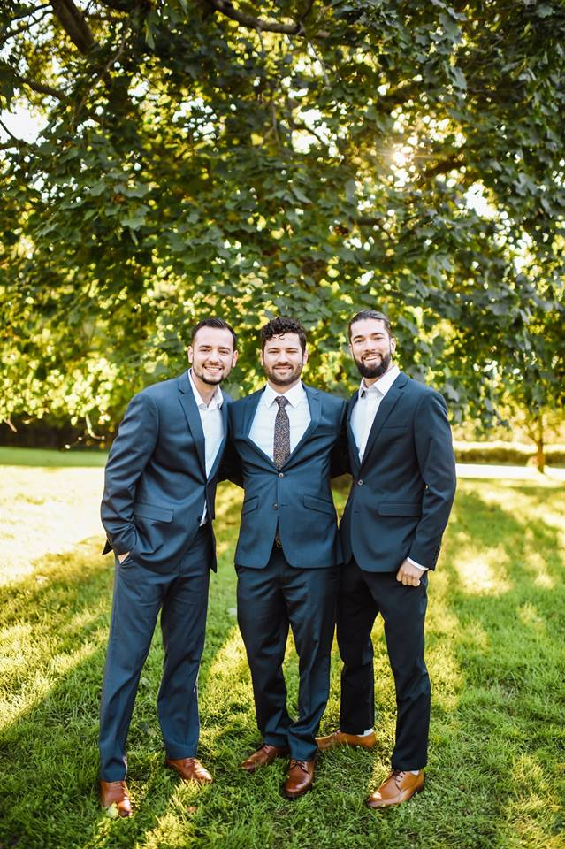
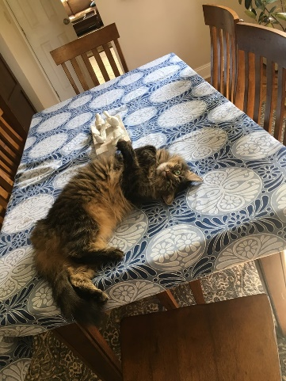
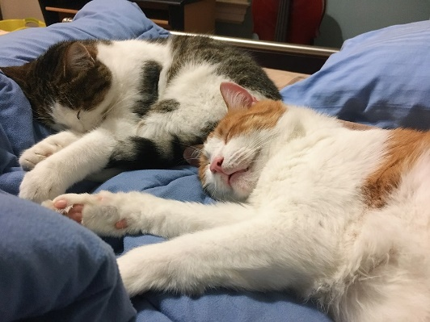
I was born and raised in Staten Island, NY and graduated from Staten Island Tech in 2014.
Mr. Rerick
A few of my favorite things:
Food: Grandma’s Red Sauce
Drink: Milk Tea
Movie: Fellowship of the Ring
Tv Show: Band of Brothers
Sport: Volleyball
I received my Bachelors in Social Studies Adolescent Education in 2018 from Hunter College. I received my MA in History at CSI in 2021.
AP World History
Volleyball Coach
I started teaching at Staten Island Tech in 2018.
What makes me happy?!
My Family, Volleyball, My Cats

Slide 4


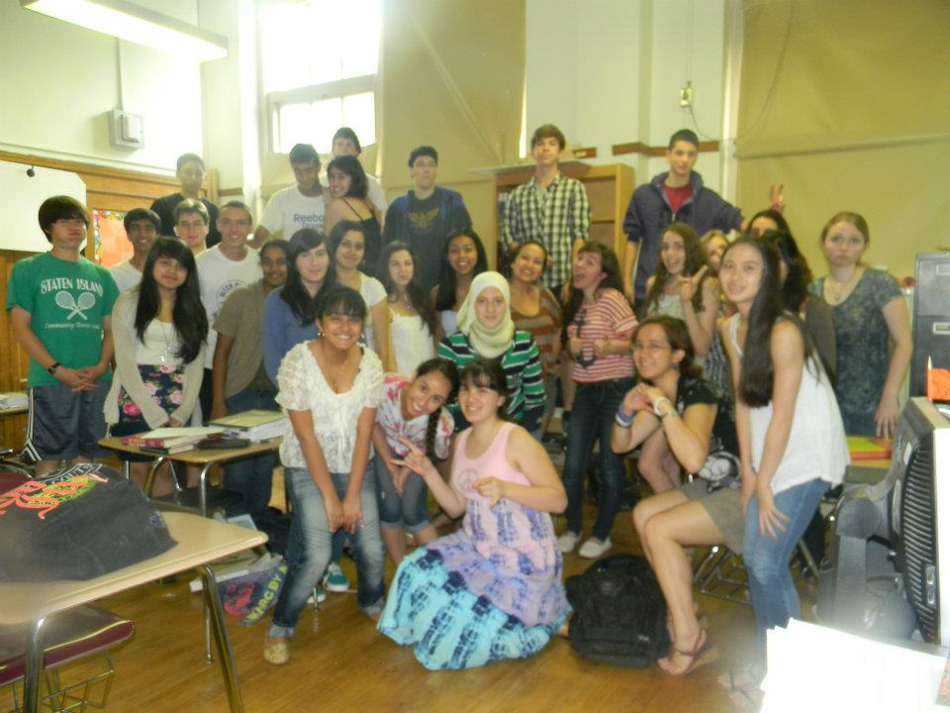

Find Mr. Rerick

Slide 5
Beginning Discussion with a Partner
Aim: How does our personal experience and collaborative inquiry contribute to the unfolding human narrative?
Listen carefully to your partner as you will introduce them before they share their answer.
Choice 1:
What’s one strength that you have?
What’s one area where you want to grow as a person?
Choice 2:
If you could have dinner with one person (they can be dead or alive) who would you pick and why?

Slide 6

Student Inquiry
Now that you know your partner’s name ask them…
1. What borough they live in…
2. Do they have any siblings…
3. Do they have any pets…
4. What’s their favorite subject…
5.Hobbies or personal interests…
6.Have they traveled recently…
7. Are they happy to be back in school…

